Slide 1

In a futuristic city where towering trees intertwined with shiny skyscrapers, lived a curious robot named Gizmo. Gizmo loved exploring every corner of the city, where nature and technology coexisted in harmony.

Slide 2
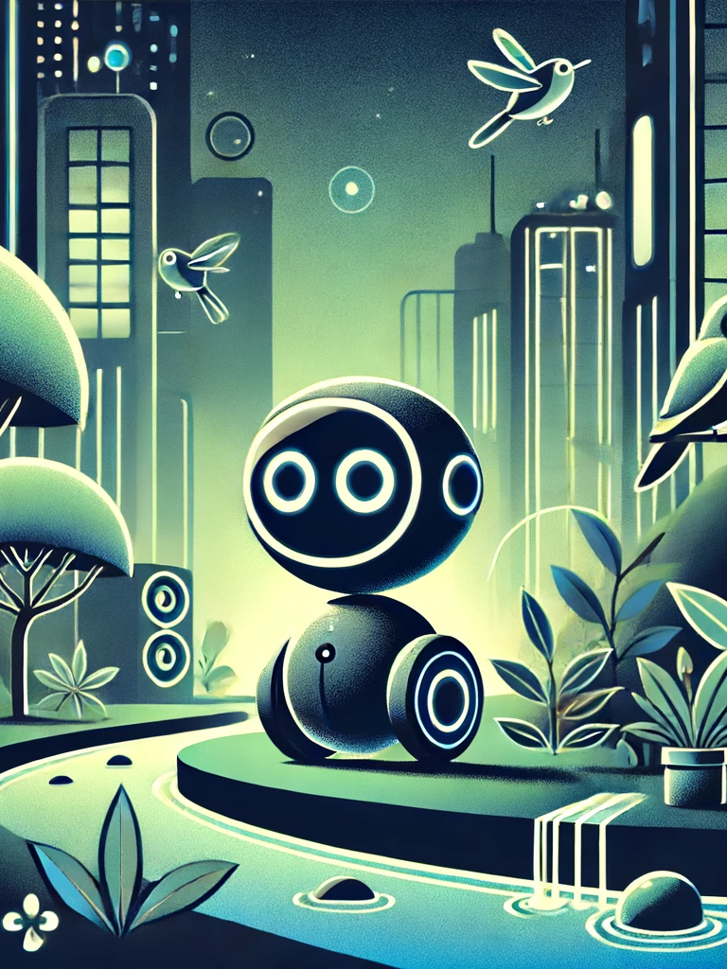
One sunny morning, Gizmo decided to venture into the lush techno-forest at the city's edge. The forest was full of wonders: glowing plants, chirping mechanical birds, and streams of crystal-clear water.

Slide 3
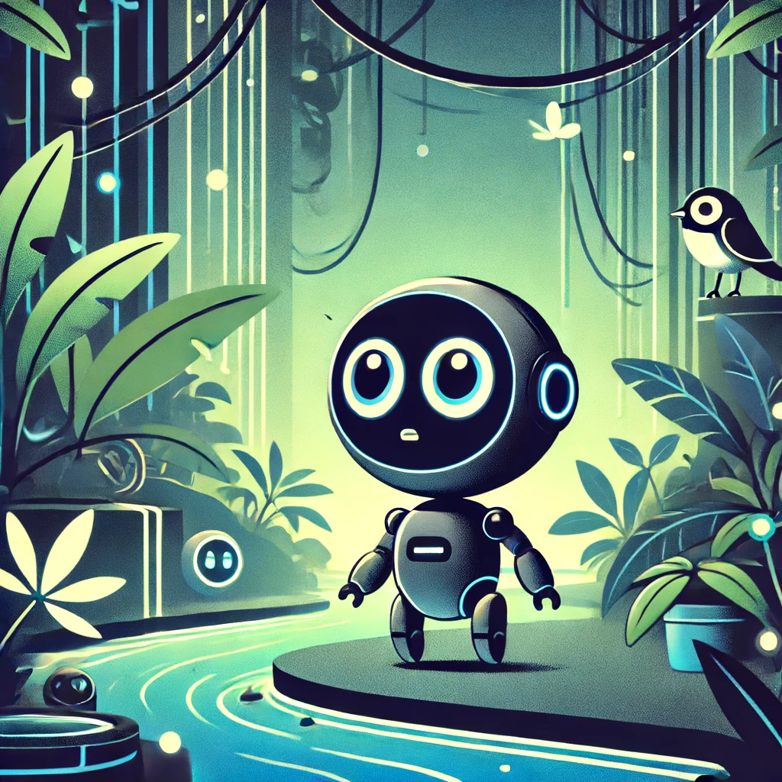
Gizmo wandered deeper and deeper, fascinated by everything around. Suddenly, Gizmo realized the familiar paths had vanished. Gizmo was lost!

Slide 4
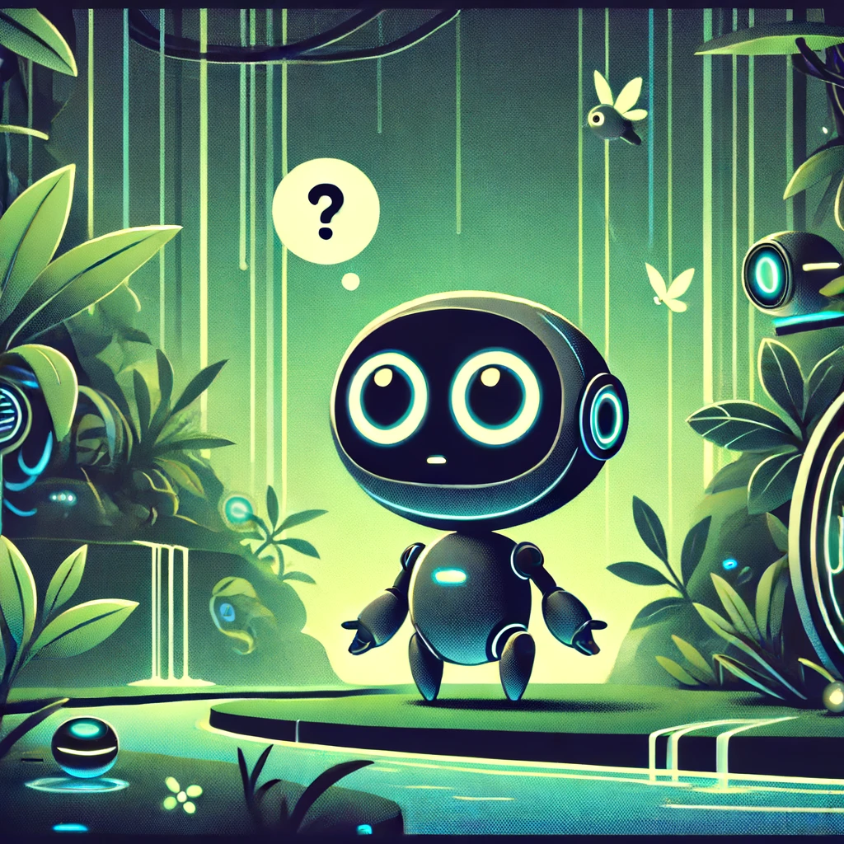
Gizmo tried to retrace his steps but ended up even more confused. He felt a little scared and very alone. But then, Gizmo remembered the wise words of his inventor: 'In times of trouble, friends can light the way.'

Slide 5
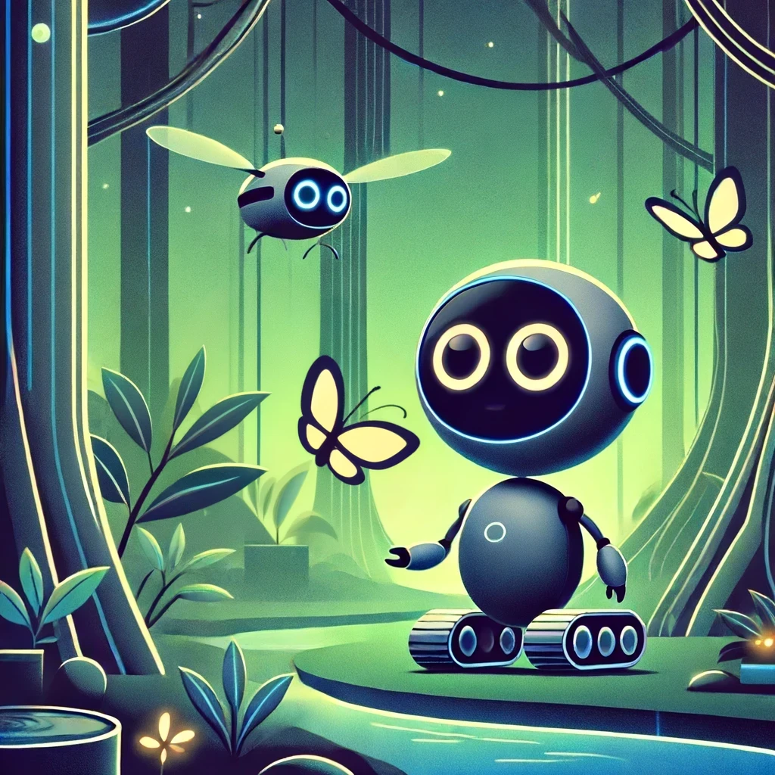
Gizmo decided to ask for help. He met Flutter, a friendly drone who loved to zip around the trees. “I’m lost, Flutter. Can you help me find my way back?” Gizmo asked.

Slide 6
Flutter nodded and buzzed ahead, but soon they hit a snag. Flutter’s navigation system was acting up due to the dense forest canopy. They needed another plan.

Slide 7
Then, Gizmo and Flutter encountered Luma, a glowing squirrel-bot who lived in the treetops. Luma used her glowing tail to signal paths through the forest. 'Follow me!' she chirped.

Slide 8
Together, Gizmo, Flutter, and Luma ventured on. They navigated through the winding trails, but the forest was vast. They still needed one more piece of the puzzle to get home.

Slide 9
Finally, they met Boulder, a strong and wise turtle-bot who knew every inch of the forest floor. Boulder agreed to help guide them back with his extensive knowledge of the forest paths.

Slide 10
With Boulder’s guidance, Flutter’s aerial view, and Luma’s glowing signals, Gizmo and his friends made their way through the forest. Step by step, they got closer to the city.

Slide 11
As the trees thinned out, the city’s familiar skyline appeared. Gizmo sighed with relief and joy. They had made it! Gizmo thanked Flutter, Luma, and Boulder for their help.

Slide 12
Gizmo learned that even the most curious robots sometimes need a helping hand from friends. Together, they could overcome any obstacle. And so, Gizmo continued to explore, knowing he had wonderful friends to count on.

Slide 13
The End

